Slide 1
Welcome to MSDS 6371 Statistical Foundations Live Session 12, January 26, 2021
Announcements
Instructor: Dr. Martin Selzer
Office Hours (Schedule Appointment by Email)
Teaching Assistant is Michael Wang
My email martin.selzer@gmail.com and mselzer@mail.smu.edu
Remember, project is available in the files folder

Slide 2
Agenda Session 11
Breakout – Live Session Questions 25 Mins 35
Review Live Session Answers 55 Mins 80
Summary, Questions 10 Mins 90

Slide 3
Session 12
Multiple Regression

Slide 4
Example for Multiple Regression – Matrix Form
A restaurant chain needs a model to predict sales. It collects data on sales, local population, and average local income from twenty of its stores.

Slide 5
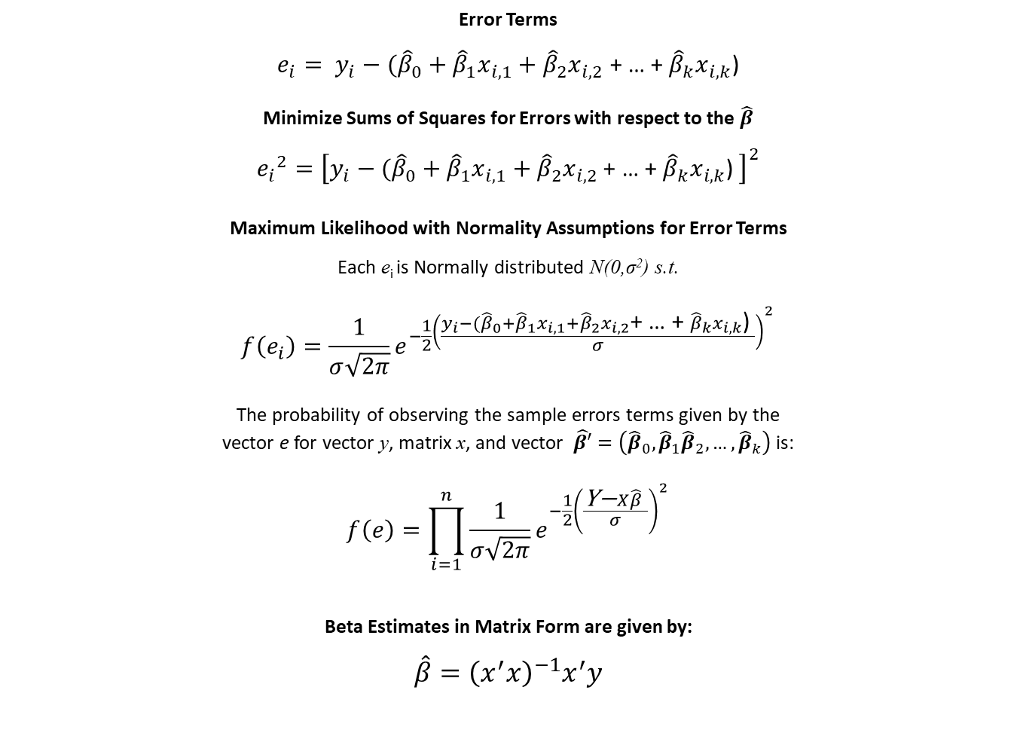
Multiple Regression – Beta Estimates
Error Terms
$e_{i}= y_{i}−({\hat{β}}_{0}+{\hat{β}}_{1}x_{i,1}+{\hat{β}}_{2}x_{i,2}$ + … + ${\hat{β}}_{k}x_{i,k}$)
Minimize Sums of Squares for Errors with respect to the $\hat{β}$
$${e_{i}}^{2}={\left[y_{i}−({\hat{β}}_{0}+{\hat{β}}_{1}x_{i,1}+{\hat{β}}_{2}x_{i,2} \text{+ … + }{\hat{β}}_{k}x_{i,k}\text{)} \right]}^{2}$$
Maximum Likelihood with Normality Assumptions for Error Terms
Each e_{i} is Normally distributed N(0,σ²) s.t.
$$f\left(e_{i}\right)=\frac{1}{σ\sqrt{2π}}e^{−\frac{1}{2}{\left(\frac{y_{i}−({\hat{β}}_{0}+{\hat{β}}_{1}x_{i,1}+{\hat{β}}_{2}x_{i,2}\text{+ … + }{\hat{β}}_{k}x_{i,k}\text{)} }{σ}\right)}^{2}}$$
The probability of observing the sample errors terms given by the
vector e for vector y, matrix x, and vector $\hat{β′}=\left({\hat{β}}_{0},{\hat{β}}_{1}{\hat{β}}_{2}, …,{\hat{β}}_{k}\right)$ is:
$$f\left(e\right)=\prod_{i=1}^{n}{\frac{1}{σ\sqrt{2π}}e^{−\frac{1}{2}{\left(\frac{\text{Y}\text{−}X\hat{β} }{σ}\right)}^{2}}}$$
Beta Estimates in Matrix Form are given by:
$$\hat{β}={\left(x^{′}x\right)}^{−1}x^{′}y$$

Slide 6
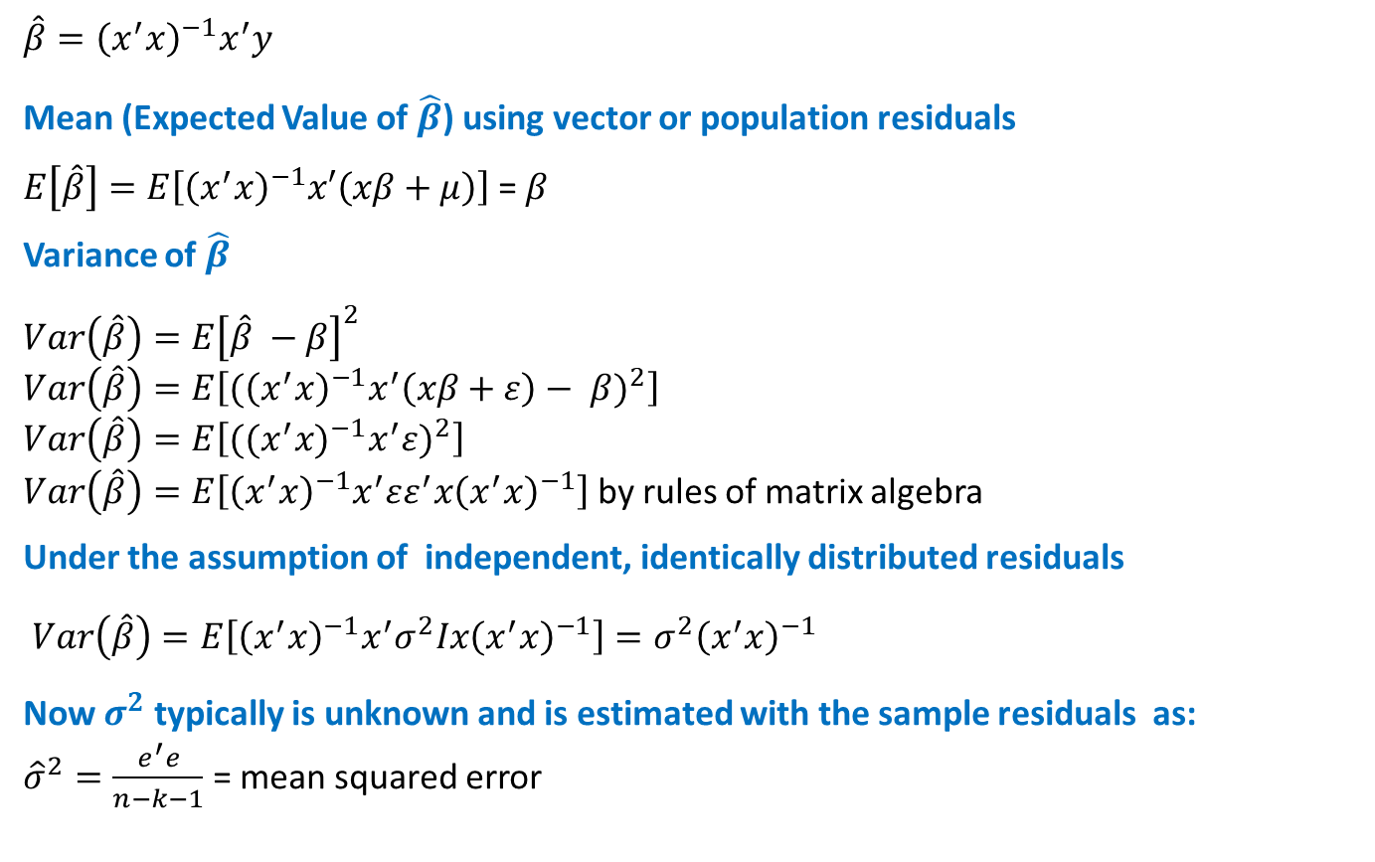
Mean and Variance of Beta Estimates
$$\hat{β}={\left(x^{′}x\right)}^{−1}x^{′}y$$
Mean (Expected Value of $\hat{β}$) using vector or population residuals
$E\left[\hat{β}\right]=E\left[{\left(x^{′}x\right)}^{−1}x′\left(xβ+μ\right)\right]$ = $β$
Variance of $\hat{β}$
$$Var\left(\hat{β}\right)=E{\left[\hat{β} −β\right]}^{2}$$
$$Var\left(\hat{β}\right)=E\left[{{(\left(x^{′}x\right)}^{−1}x^{′}\left(xβ+ε\right)− β)}^{2}\right]$$
$$Var\left(\hat{β}\right)=E\left[({{(x^{′}x)}^{−1}x^{′}ε)}^{2}\right]$$
$Var\left(\hat{β}\right)=E\left[{\left(x^{′}x\right)}^{−1}x^{′}εε^{′}x{\left(x^{′}x\right)}^{−1}\right]$ by rules of matrix algebra
Under the assumption of independent, identically distributed residuals
$Var\left(\hat{β}\right)=E\left[{\left(x^{′}x\right)}^{−1}x^{′}σ^{2}Ix{\left(x^{′}x\right)}^{−1}\right]={σ^{2}\left(x^{′}x\right)}^{−1}$
Now $σ^{2}$ typically is unknown and is estimated with the sample residuals as:
${\hat{σ}}^{2}=\frac{e^{′}e}{n−k−1}$ = mean squared error

Slide 7
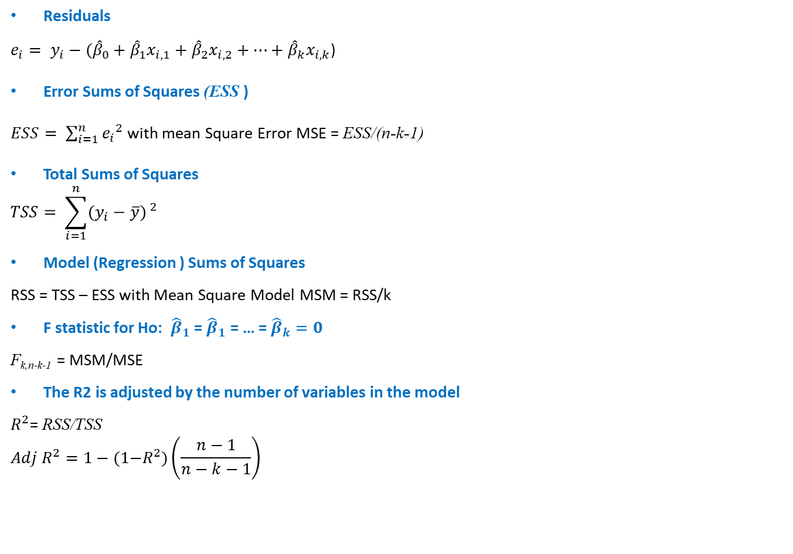
Multiple Regression SS, Adj R², F
Residuals
$e_{i}= y_{i}−({\hat{β}}_{0}+{\hat{β}}_{1}x_{i,1}+{\hat{β}}_{2}x_{i,2}+…+{\hat{β}}_{k}x_{i,k}$)
Error Sums of Squares (ESS )
$ESS= \sum_{i=1}^{n}{{e_{i}}^{2}}$ with mean Square Error MSE = ESS/(n-k-1)
Total Sums of Squares
$$TSS= \sum_{i=1}^{n}{{(y_{i}−\overline{y})}^{ 2}}$$
Model (Regression ) Sums of Squares
RSS = TSS – ESS with Mean Square Model MSM = RSS/k
F statistic for Ho: ${\hat{β}}_{1}$ = ${\hat{β}}_{1}$ = … = ${\hat{β}}_{k}=0$
F_{k,n-k-1} = MSM/MSE
The R2 is adjusted by the number of variables in the model
$R^{2}$= RSS/TSS
$$Adj R^{2}=1−(1{−R}^{2})\left(\frac{n−1}{n−k−1}\right)$$

Slide 8
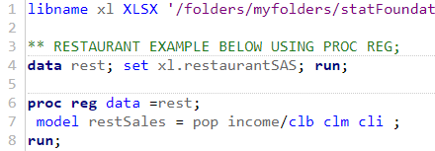
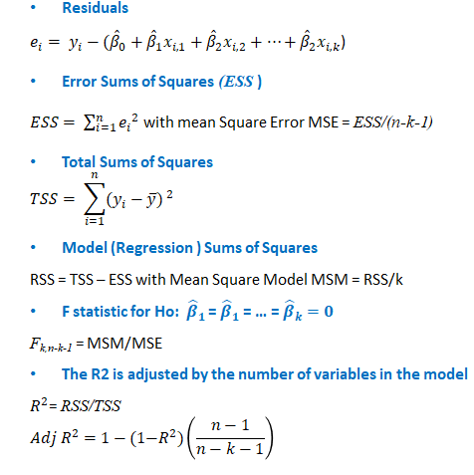
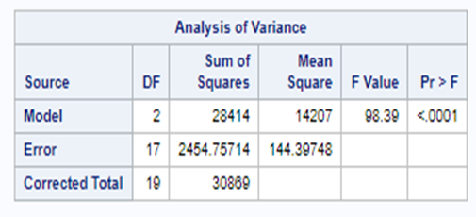
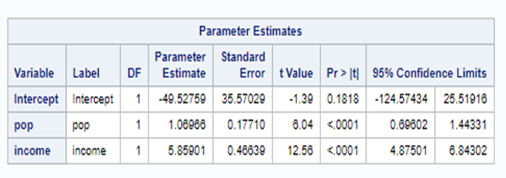
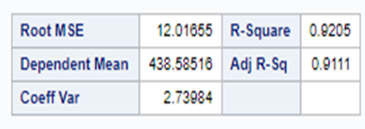
Restaurant Sales Example SAS
t_{n-k-1} = Estimate/Std.Err.

Slide 9
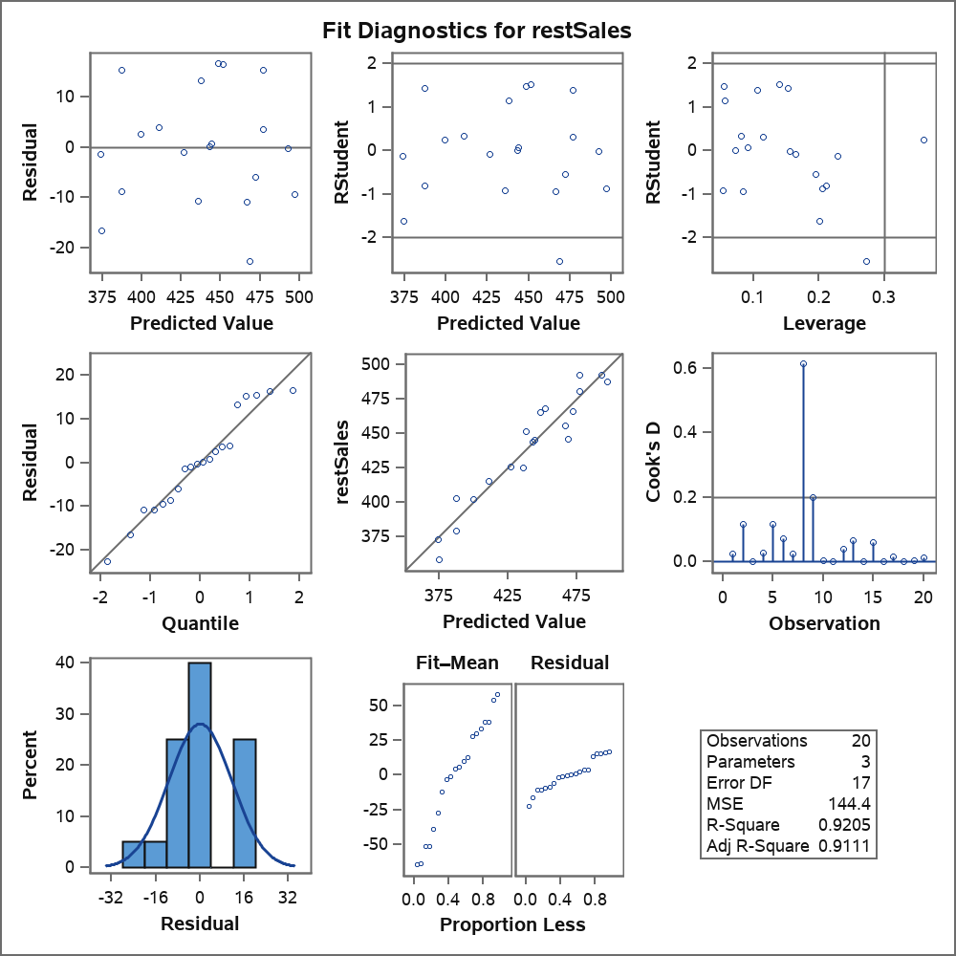
Restaurant Sales Example Residuals SAS

Slide 10
Restaurant Sales Example SAS Regression Predictions
Output Statistics
Obs | Dependent Variable | Predicted Value | Std Error Mean Predict | 95% CL Mean |  | 95% CL Predict |  | Residual
1 | 451 | 437.8605 | 2.8588 | 431.8290 | 443.8921 | 411.8002 | 463.9208 | 13.2144
2 | 402 | 387.1722 | 4.6963 | 377.2638 | 397.0806 | 359.9520 | 414.3923 | 15.3196
3 | 492 | 492.7310 | 4.7379 | 482.7349 | 502.7271 | 465.4788 | 519.9832 | -0.3285
4 | 456 | 466.6449 | 3.4802 | 459.3023 | 473.9875 | 440.2503 | 493.0395 | -10.8977
5 | 468 | 451.6213 | 4.4839 | 442.1612 | 461.0815 | 424.5612 | 478.6815 | 16.3993
6 | 492 | 476.7343 | 3.9054 | 468.4946 | 484.9740 | 450.0763 | 503.3924 | 15.3999
7 | 466 | 472.0415 | 5.3147 | 460.8285 | 483.2545 | 444.3198 | 499.7632 | -5.9901
8 | 446 | 468.6394 | 6.2801 | 455.3895 | 481.8893 | 440.0331 | 497.2457 | -22.6788
9 | 358 | 374.3845 | 5.3879 | 363.0170 | 385.7520 | 346.6000 | 402.1690 | -16.5913
10 | 415 | 411.1672 | 3.4292 | 403.9323 | 418.4021 | 384.8024 | 437.5320 | 3.8735
11 | 443 | 443.2088 | 3.2366 | 436.3803 | 450.0374 | 416.9526 | 469.4651 | 0.1513
12 | 465 | 448.5089 | 2.8072 | 442.5863 | 454.4315 | 422.4736 | 474.5442 | 16.6523
13 | 488 | 497.0579 | 5.4415 | 485.5774 | 508.5384 | 469.2269 | 524.8889 | -9.4102
14 | 445 | 444.1820 | 3.6333 | 436.5164 | 451.8475 | 417.6957 | 470.6682 | 0.7599
15 | 379 | 387.2687 | 5.5319 | 375.5974 | 398.9401 | 359.3585 | 415.1789 | -8.7248
16 | 426 | 426.5567 | 4.8646 | 416.2932 | 436.8201 | 399.2053 | 453.9080 | -0.9985
17 | 425 | 435.7212 | 2.7732 | 429.8702 | 441.5722 | 409.7021 | 461.7403 | -10.7425
18 | 372 | 373.8255 | 5.7380 | 361.7194 | 385.9316 | 345.7307 | 401.9203 | -1.4668
19 | 480 | 476.7826 | 4.0653 | 468.2054 | 485.3597 | 450.0183 | 503.5469 | 3.5408
20 | 402 | 399.5940 | 7.2110 | 384.3802 | 414.8078 | 370.0268 | 429.1612 | 2.5180

Slide 11
Restaurant Sales Example: R Code
##### R CODE FOR RESTAURANT MODEL
restData <- read.xlsx ("C:\\Users\\Martin\\Documents\\SASUniversityEdition\\myfolders\\statFoundations\\session12\\session12Data.xlsx", "restaurantSAS")
rest.lm <- lm(restSales ~ pop + income, data=restData)
summary(rest.lm)
##Three of the graphs can be obtained by simply plotting the model fit
par(mfrow=c(2,2))
plot(rest.lm, which=c(1:3))
##Histogram with normal curve Store studentized residuals
studresRest <- rstudent(rest.lm)
##Histogram
hist(studresRest, freq=FALSE, main="Distribution of Studentized Residuals",
xlab="Studentized Residuals", ylab="Density", ylim=c(0,0.5))
##Create range of x-values for normal curve
xfit2 <- seq(min(studresRest)-1, max(studresRest)+1, length=40)
##Generate values from the normal distribution at the specified values
yfit2 <- (dnorm(xfit2))
##Add the normal curve
lines(xfit2, yfit2, ylim=c(0,0.5))

Slide 12
Charity Example Multiple Regression and Categorical Variables
The data gives the wealth level of people (wealth) and the amount of money they gives to Charity (charity). It also measures the importance (Imp) each subject attributes to charity based on a scale derived from survey questions. Wealth is divided into two levels > $45,000 and <= $45,000 .

Slide 13
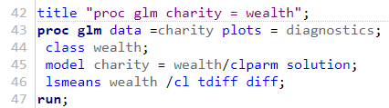
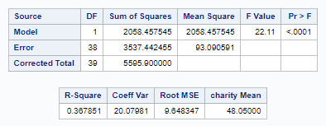



Charity Example: Run Proc GLM Model Charity = Wealth; *(Categorical Variable);
Intercept Reference Category
Mean of Charity of RICHER Category
wealth Rich
Mean of Charity of RICH Category
is Intercept – wealthRich = 54.2 - 14.5 = 39.7
t test for Difference of Means
Confidence Interval for Difference of Means

Slide 14

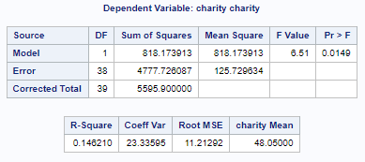

Charity Example: Run Proc GLM Model Charity = Imp; *(Continuous Variable); This is like simple one variable regression

Slide 15

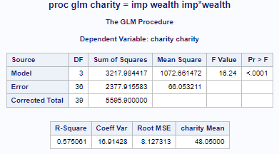
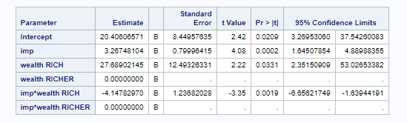
Charity Example: Now Combine the Categorical and Continuous Variable into One Model and Analyze Interactions
Looks like Interaction so Analyze charity , imp controlling for Wealth Level

Slide 16
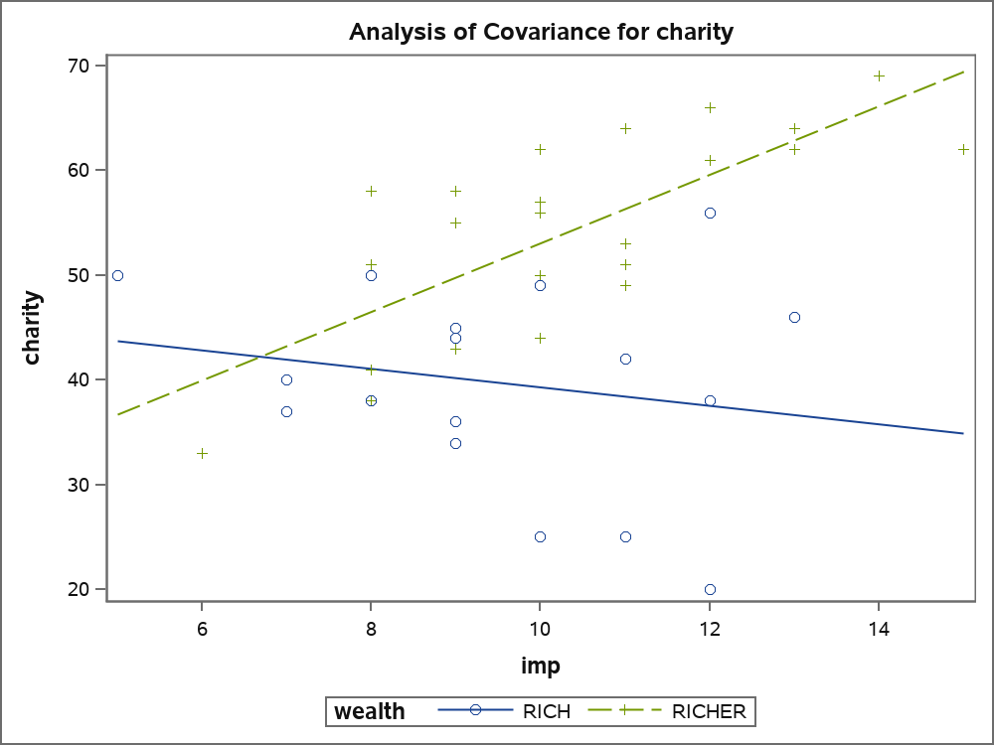
Charity Example: Graphic of Interaction Model model charity = imp; *For Each Wealth Level;

Slide 17
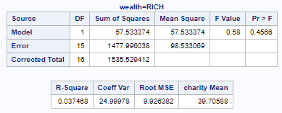
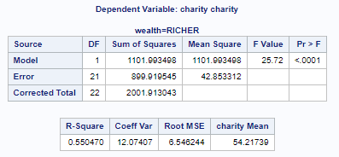


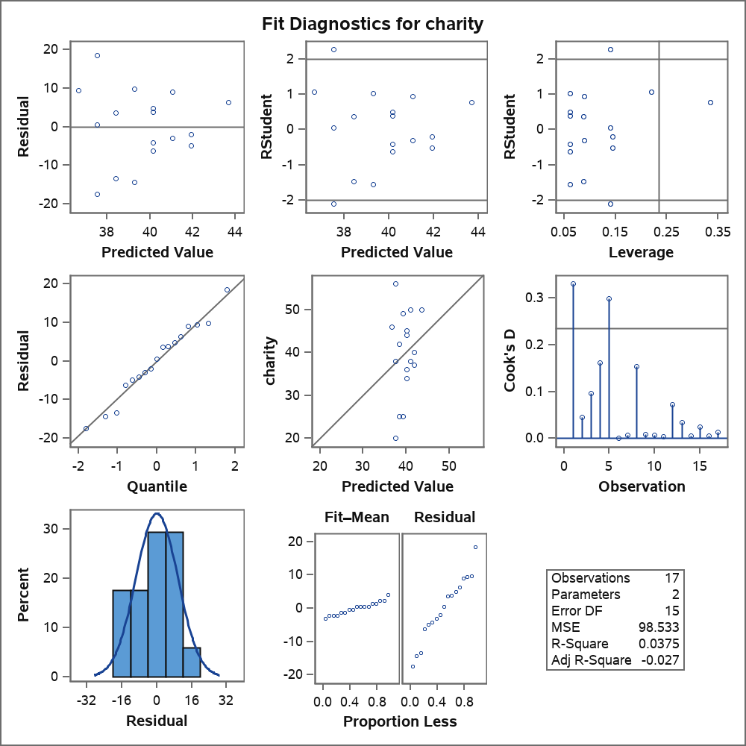
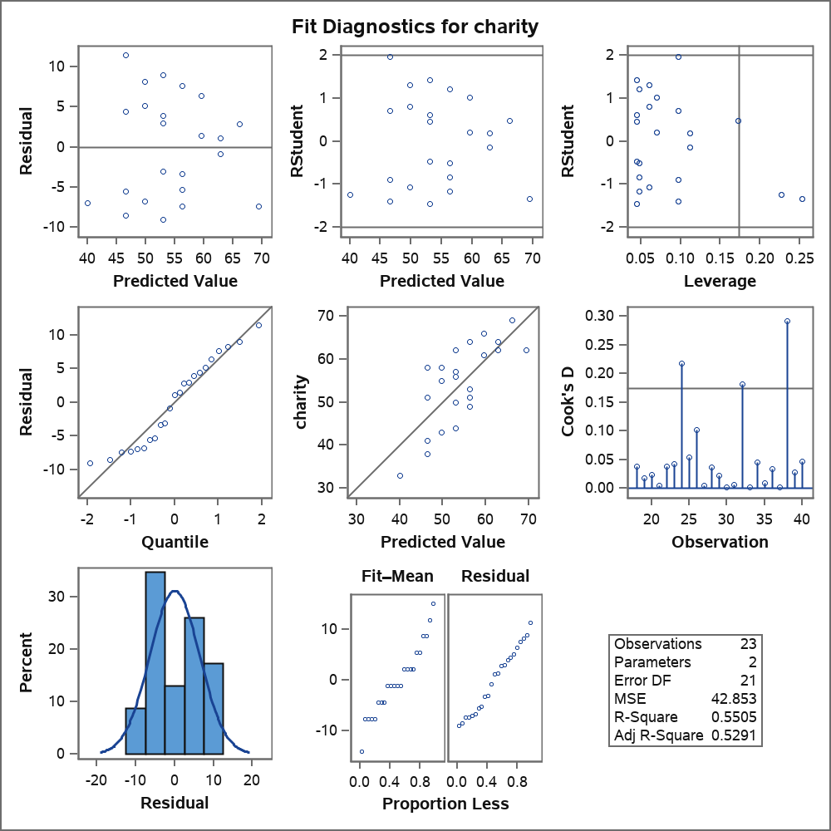
Charity Example Analyze model charity = imp Controlling for Wealth Level
Wealth = RICH
Wealth = RICHER

Slide 18
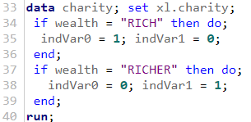
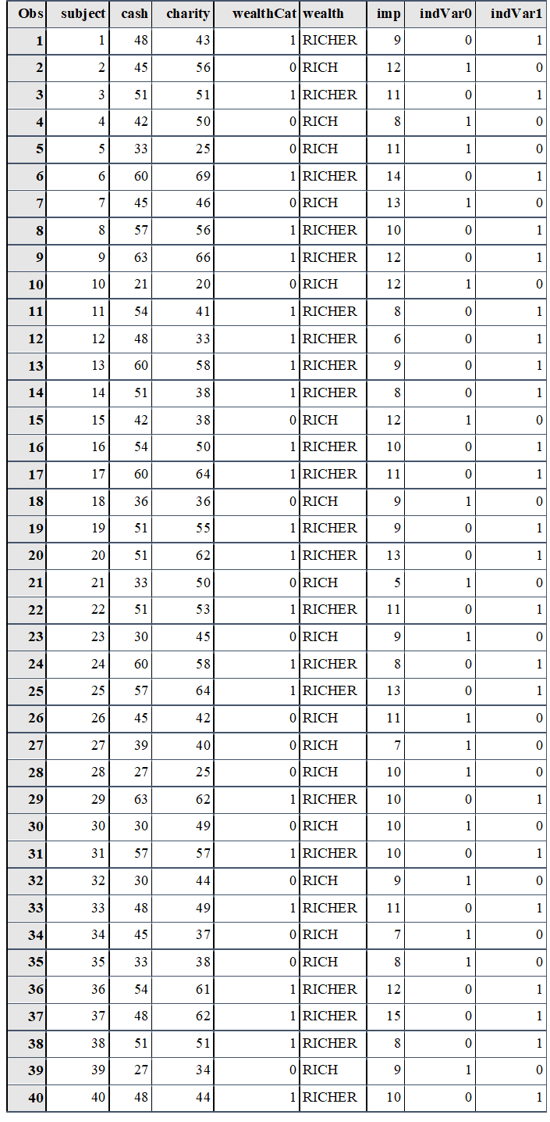
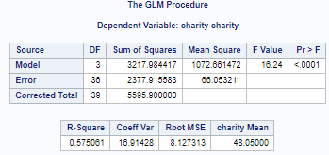
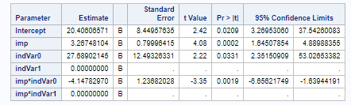
Charity Example: Can Do Interaction model with Indicator Variables and proc glm

Slide 19
Charity Example: R-Code for Interaction Model
##### R CODE FOR CHARITY MODEL
charityData <- read.xlsx ("C:\\Users\\Martin\\Documents\\SASUniversityEdition\\myfolders\\statFoundations\\session12\\session12Data.xlsx", "charity")
charityData
charity.lm <- lm(charity ~ imp + wealth +imp*wealth, data=charityData)
summary(charity.lm)
##Three of the graphs can be obtained by simply plotting the model fit
par(mfrow=c(2,2))
plot(charity.lm, which=c(1:3))
##Histogram with normal curve Store studentized residuals
studresRest <- rstudent(charity.lm)
##Histogram
hist(studresRest, freq=FALSE, main="Distribution of Studentized Residuals",
xlab="Studentized Residuals", ylab="Density", ylim=c(0,0.5))
##Create range of x-values for normal curve
xfit2 <- seq(min(studresRest)-1, max(studresRest)+1, length=40)
##Generate values from the normal distribution at the specified values
yfit2 <- (dnorm(xfit2))
##Add the normal curve
lines(xfit2, yfit2, ylim=c(0,0.5))

Slide 20
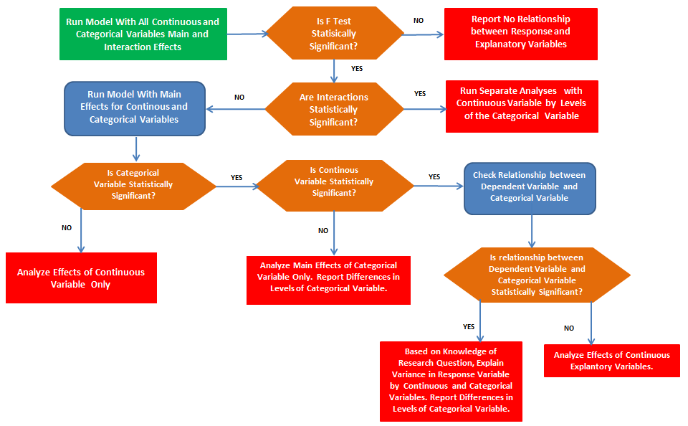
Modeling Guide for Multivariate Regression with Categorical Variables

Slide 21
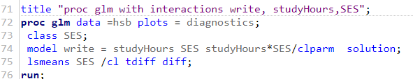
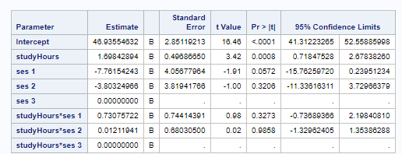
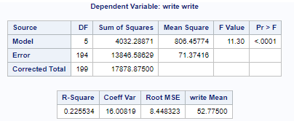
HSB Example Understanding Student Writing Skills Model With Interaction

Slide 22
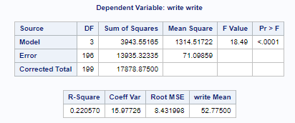
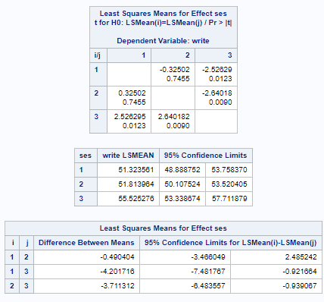
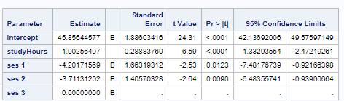
HSB Example Understanding Student Writing Skills Model Without Interaction

Slide 23
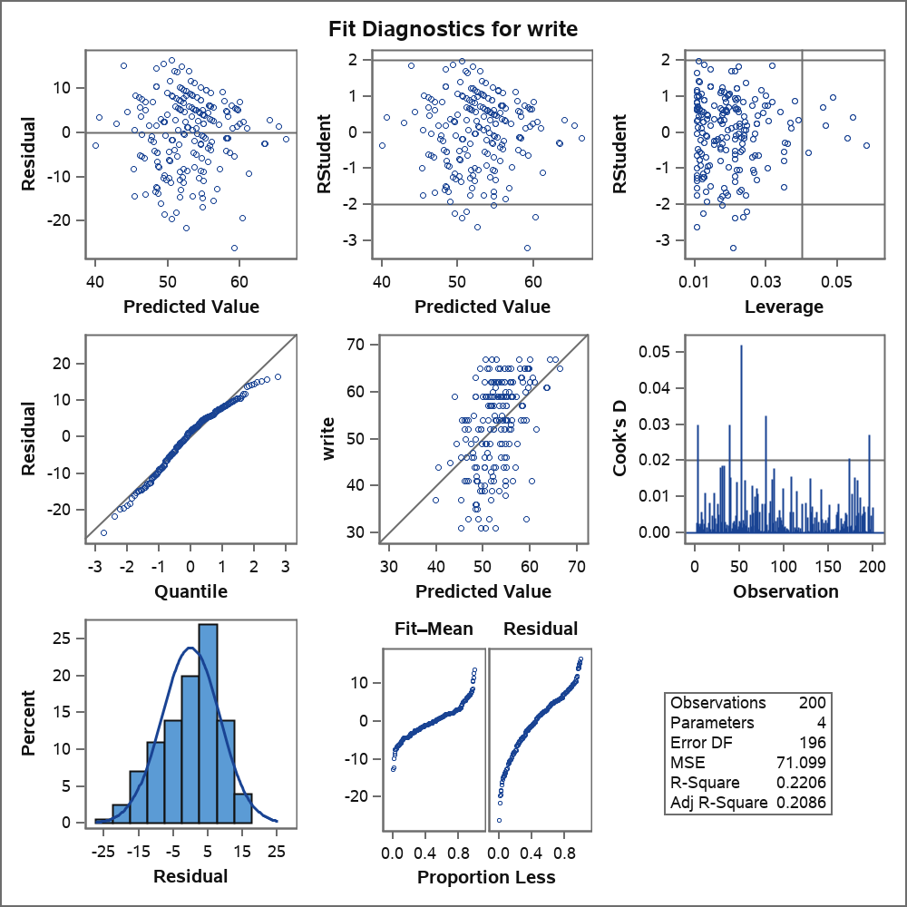
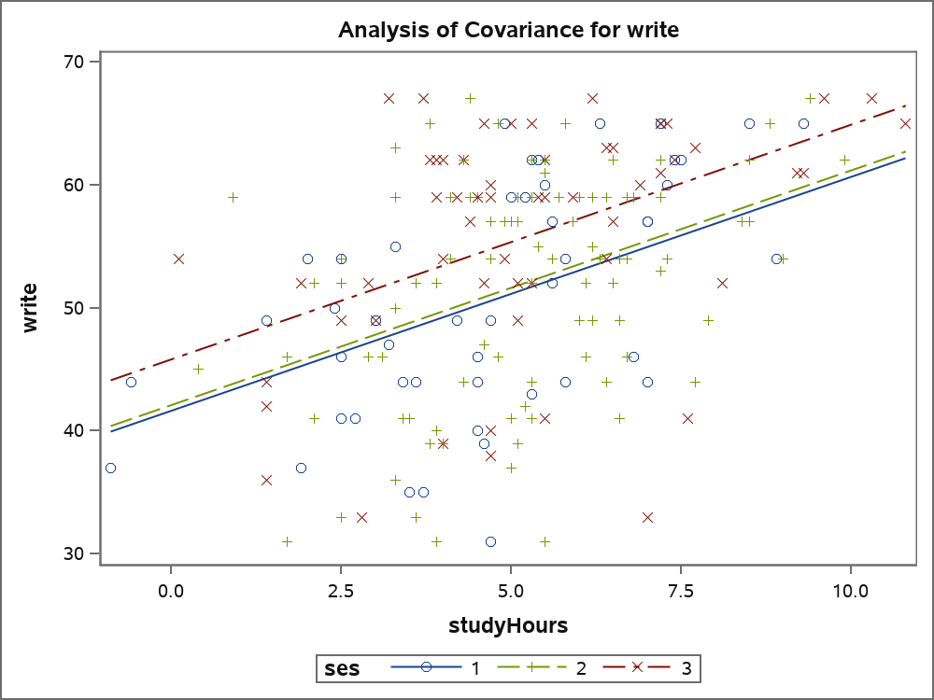
HSB Example Understanding Student Writing Skills Main Effects Model Without Interaction Model Graphics

Slide 24
Part 1: Quick Quiz Questions

Slide 25
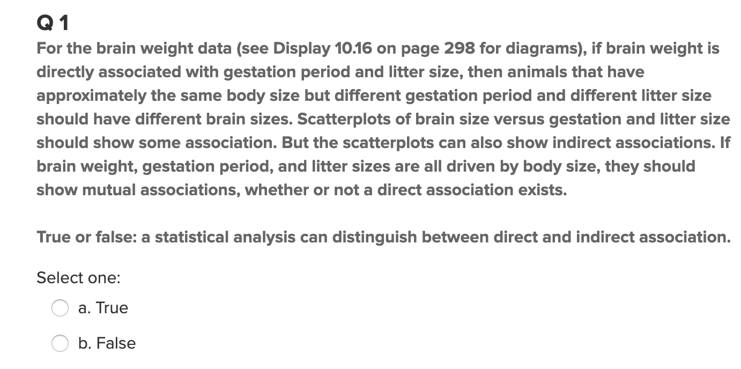
Quick Quiz Question 1
See page 309 in the text

Slide 26
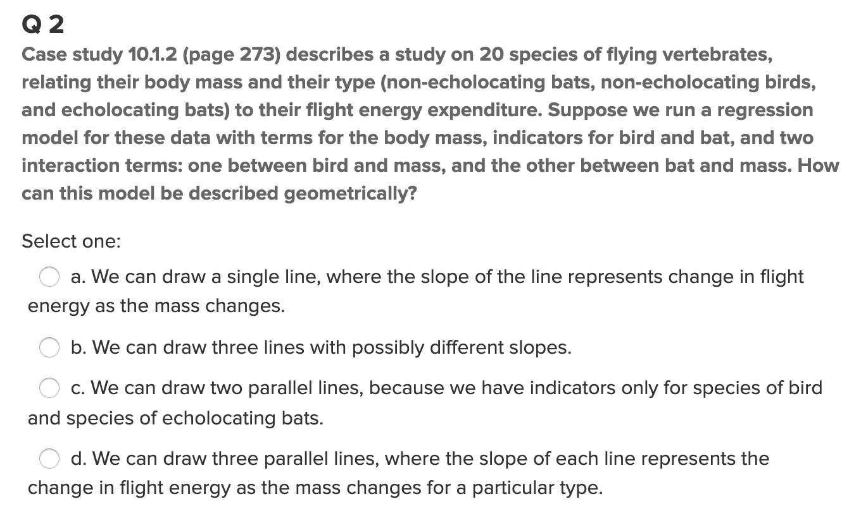
Quick Quiz Questions 2

Slide 27
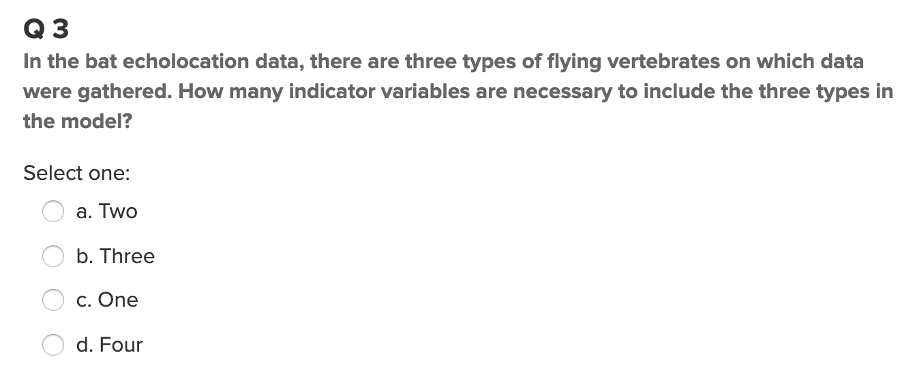
Quick Quiz Question 3

Slide 28
Exercise: Meadowfoam
Meadowfoam is a small plant found in moist meadows of the U.S. Pacific Northwest. It has been domesticated and it's seed oil is highly desirable because it is non-greasy and highly stable. Researchers were interested in understanding how to increase Meadowfoam flowering by controlling light intensity (Continuous variable) and a photo period (Early, 24 days before PFI vs. Late, at the start of PFI). Photo period is a categorical variable.
Run and interpret a model with interactions to understand flowering.
Evaluate if more analysis is required.
Report on categorical differences and statistical tests and manually validate differences.
Discuss your final model with regards to statistical results and assumptions.

Slide 29
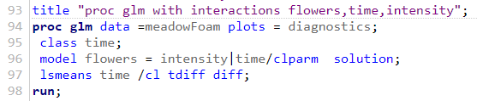
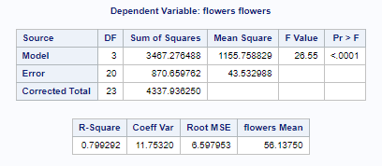
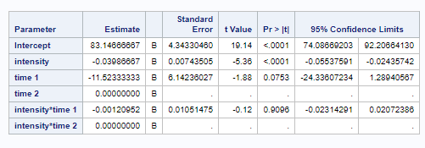
Exercise Meadowfoam Interactions Model
Interaction is not significant.

Slide 30
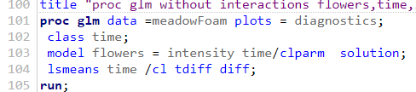
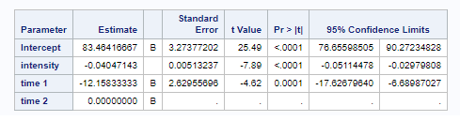
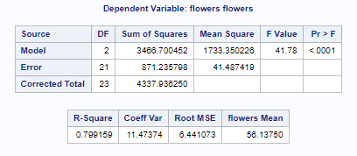
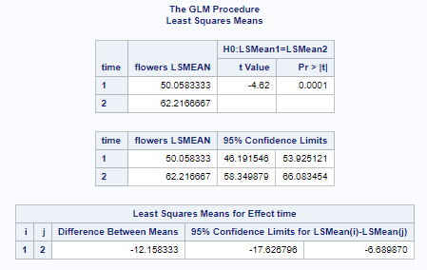
Exercise Meadowfoam Main Effects Model

Slide 31
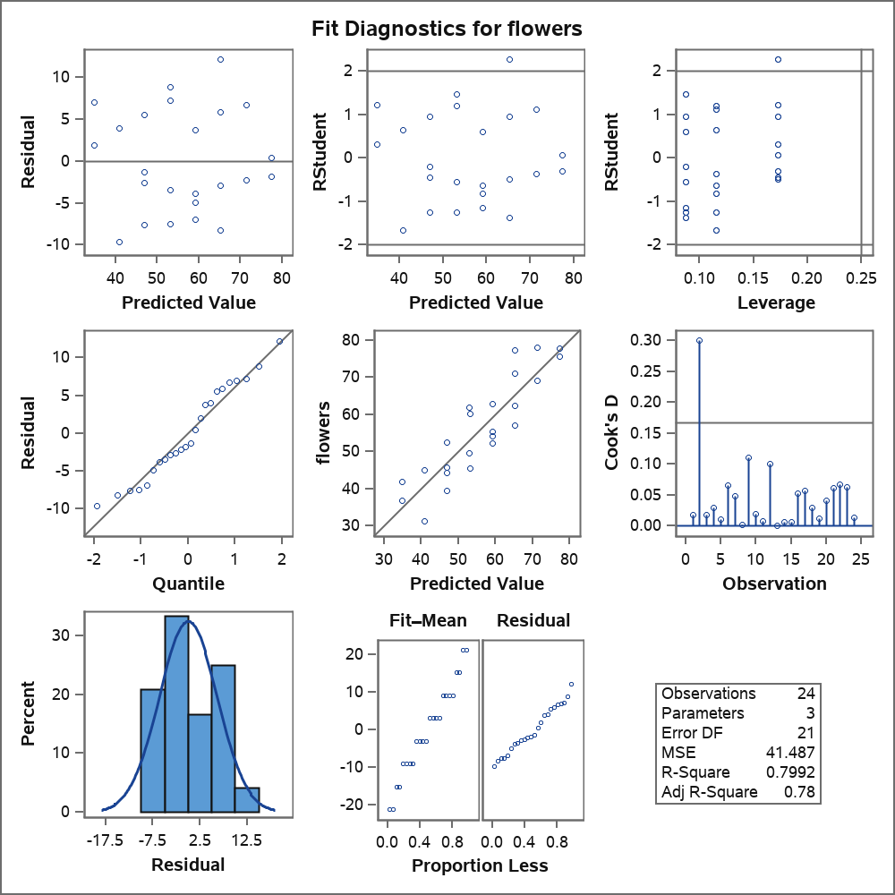
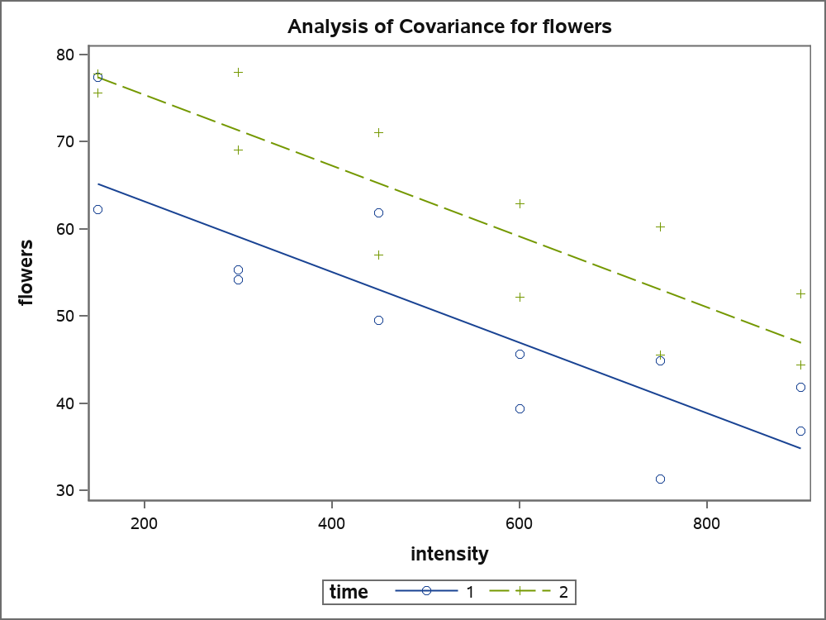
Exercise Meadowfoam Main Effects Model Graphics

Slide 32
Meadowfoam Example R Code for Interaction Model
library(xlsx)
##### R CODE FOR meadow MODEL
meadowData <- read.xlsx ("C:\\Users\\Martin\\Documents\\SASUniversityEdition\\myfolders\\statFoundations\\session12\\session12Data.xlsx", "meadowFoam")
meadowData
meadow.lm <- lm(flowers ~ intensity + time +intensity*time, data=meadowData)
summary(meadow.lm)
##Three of the graphs can be obtained by simply plotting the model fit
par(mfrow=c(2,2))
plot(meadow.lm, which=c(1:3))
##Histogram with normal curve Store studentized residuals
studresRest <- rstudent(meadow.lm)
##Histogram
hist(studresRest, freq=FALSE, main="Distribution of Studentized Residuals",
xlab="Studentized Residuals", ylab="Density", ylim=c(0,0.5))
##Create range of x-values for normal curve
xfit2 <- seq(min(studresRest)-1, max(studresRest)+1, length=40)
##Generate values from the normal distribution at the specified values
yfit2 <- (dnorm(xfit2))
##Add the normal curve
lines(xfit2, yfit2, ylim=c(0,0.5))

Slide 33
Summary
Multiple regression uses more than one independent variable.
Regressions can be run with continuous and categorical independent variables.
In SAS, use proc glm and a class statement for categorical variables.
Interactions between categorical and continuous independent variables are important to analyze.
Depending on results from including all continuous and categorical independent variables, models should be refined.

